Slide 1


Cellula
Task 1
JOHN SHOUKRY
Page 1

Slide 2


Introduction
Performing EDA on a given Dataset for Hotel Reservations
Given that Cancellations in the hotel industry are a significant challenge. They lead to revenue loss, operational inefficiencies, and wasted resources.
Page 2

Slide 3
EDA
Exploratory Data Analysis or EDA is an approach to determine key attributes, get insight, determine patterns in data, spot anomalies, and identify relationships between variables in raw data using numbers, tables, and graphs. It is always a good practice to know about the data before you start working on it.
Page 3

Slide 4
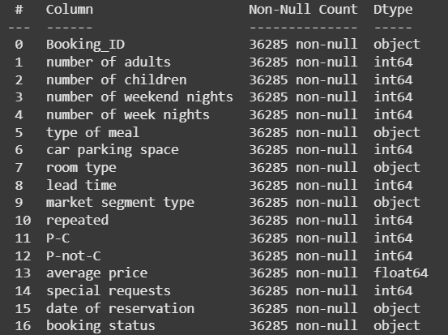
Dataset Overview
Consists of ( rows:36285 x columns:17 )
data set doesnot contain Null values or duplicate values
data info ( data types of each column) :
Page 4

Slide 5
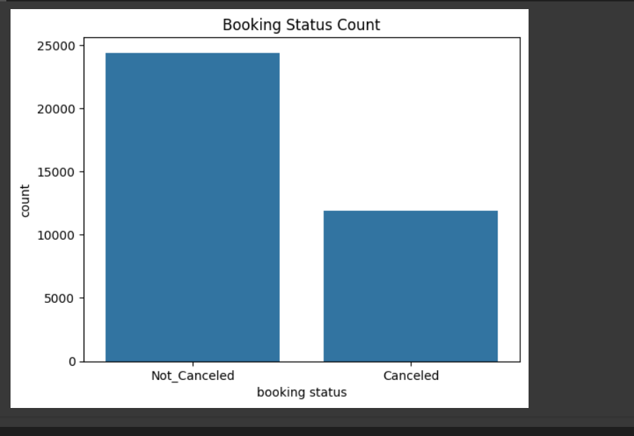
Data insights
Number of canceled Reservation: 11889
percentage of canceled Reservations is 32.77%
which is high percentage, our task is to find what are the features that influenece the customers to cancel their reservation to adjust them and help the business grow more efficiently.
Page 5

Slide 6
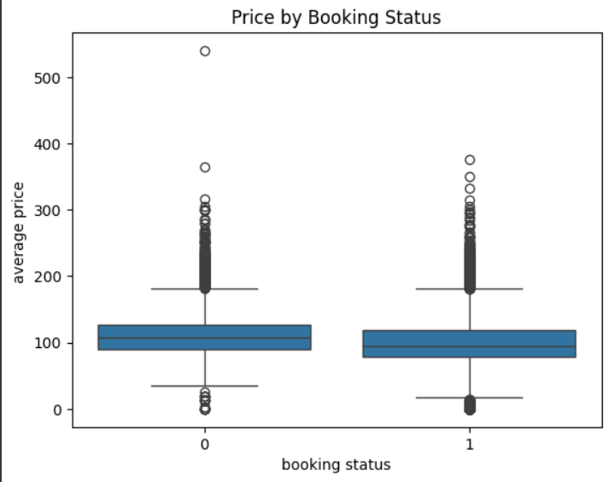
Average price influence on booking status
customers who paid higher prices were more likely to cancel their reservations.
This might suggest:
They expected something high from the hotel and got disappointed so they canceled the reservations
Page 6

Slide 7
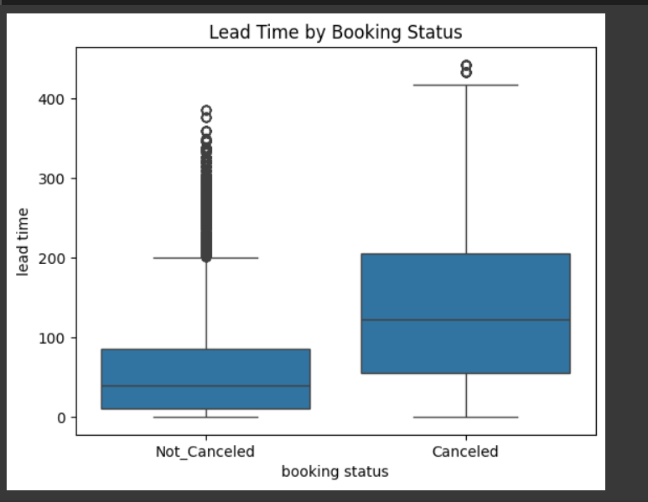
lead Time influence on booking status
Customers who Reserved far in advance were more likely to cancel their reservations.
This might suggest:
They Found a better deal or an offer from other hotels
Page 7

Slide 8
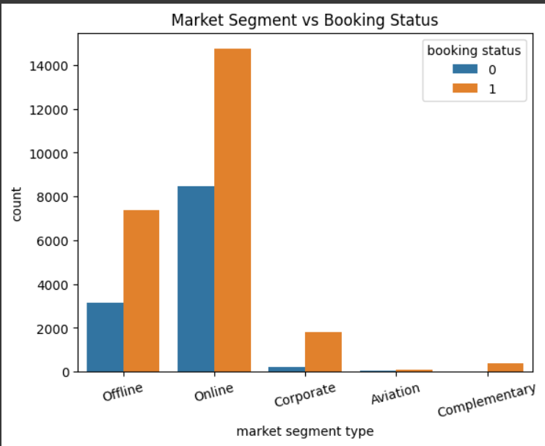
Market Type influence on booking status
Online segment has the highest number of bookings, but also the highest number of cancellations.
Offline bookings are more balanced but still have more cancellations.
Corporate, Aviation, and Complementary segments show much lower volume overall.
The Corporate segment, despite its smaller size, shows a notable cancellation rate.
Page 8

Slide 9
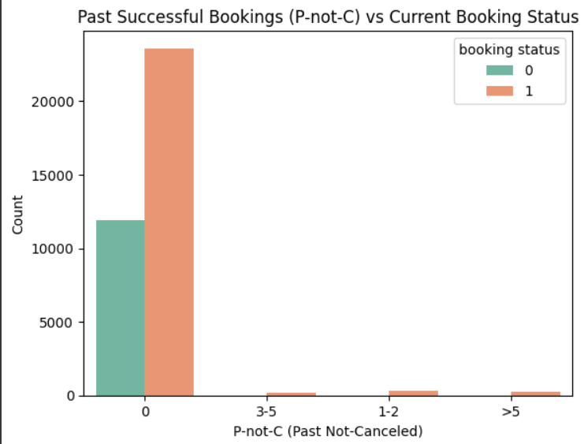
P_not_c influence on booking status
customers who Reserved before and didnot cancel shows that the are less likely to cancel reservations
Page 9

Slide 10
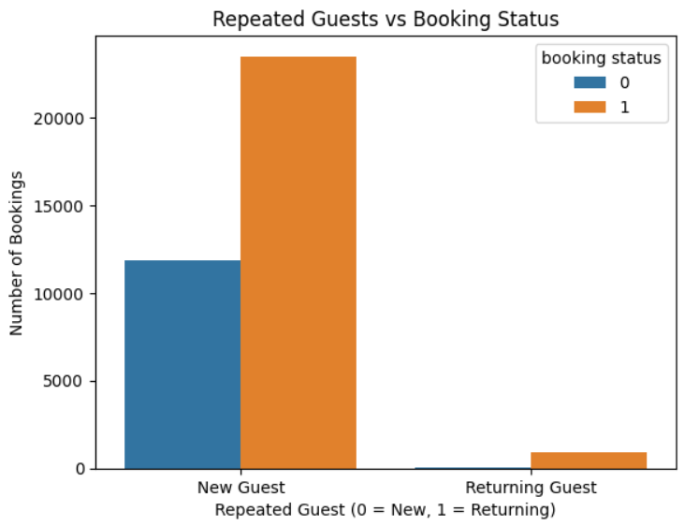
Repeated influence on booking status
customers who Came before to the Hotel are less likely to cancel the reservation
New guests (Repeated = 0) show a higher cancellation rate, possibly due to uncertainty or better deals
Page 10

Slide 11
Conclusion
High Cancellation Rate: 32.77% of bookings are canceled, impacting revenue and operations.
Key Drivers:
Price: Higher prices correlate with more cancellations (potential dissatisfaction).
Lead Time: Longer advance bookings increase cancellations (customers may find better deals).
Market Segment: Online bookings dominate but have the highest cancellation risk.
Repeat Guests: Returning customers are less likely to cancel.
Page 11

Slide 12
Recommendation
Offer incentives for early reservations to reduce last-minute cancellations.
Target retention strategies for repeat guests (loyalty programs).
Next Steps
Build a predictive Model to deduce the cancelation rate based on given data
Page 12

Slide 13
Thank You
FOR YOUR ATTENTION
Page 13

